Slide 1
Exposures (WC LOB)
Introduction to ClaimCenter 4.0:
Product Features and Capabilities
4.1-WC
The Adjudication Process
4.0.2
01/17/2008
Notes:
Guidewire training materials contain Guidewire’s confidential information subject to confidentiality and non-disclosure agreements. You agree to use the information in this manual solely for the purpose of training to implement Guidewire’s software solutions. You also agree not to disclose the information in this manual to third parties or copy this manual without Guidewire’s prior written consent. Guidewire training may only be given by Guidewire employees or certified Guidewire partners under the appropriate agreement with Guidewire.

Slide 2
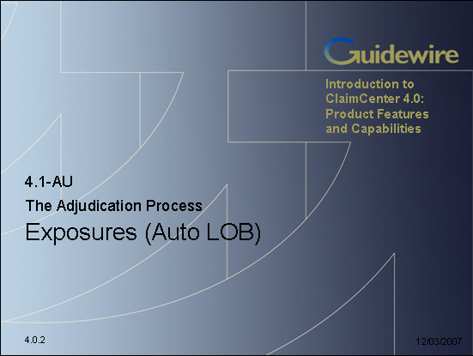

The Two Exposure Lessons
The way in which exposures are created and viewed is significantly different for the auto/property lines of business and the worker's comp line of business. Therefore, this course has two Exposures lessons. Most of the information is the same across the two lessons, so you only need to complete one of them.
Notes:
The Workers' Comp exposure lesson exists primarily for customers who are primarily interested in workers' comp claims. Students who are interested in having a general knowledge of ClaimCenter are recommended to complete the Auto version. Students who are interested in understanding both lines of business should complete the Auto lesson first and then review the latter two sections in the Workers' Comp lesson.

Slide 3
Lesson Objectives
By the end of this lesson, you should be able to:
  Describe the primary information tracked in an exposure
  Create exposures

Slide 4
Lesson Outline
Review of the Claims Process
Workers' Comp Exposure Basics
Working with Exposures

Slide 5
Review: The Claims Process (Business Perspective)
Litigation
Fraud Detection
Intake
Special Investigations
Adjudication
Payment
Recovery
Notes:
During intake, the carrier is informed of a potentially covered loss. For auto and property claims, this is often referred to as First Notice of Loss (FNOL). For workers' comp claims, this is also known as First Report or Injury (FROI) or First Notice of Injury (FNOI).
Adjudication is the process of determining if you are going to pay a claim, and if so, how much you are going to pay.
Once the loss has been assessed and the payment has been approved, the carrier can provide the payments to the claimants. The payment phase involves creating, approving, and issuing the checks.
In some cases, the carrier may also attempt to recover funds paid to the claimant by obtaining money from a third party's carrier if the third party was at fault (which is known as "subrogation") or by taking possession of a significantly damaged property and selling all or parts of it to a third party (which is known as "salvage").
Litigation is an umbrella term for several activities which involve the resolution of disputes.
Fraud detection refers to the activities around detecting claim activity that is indicative of fraud and could warrant further investigation. This is typically a process which is ongoing throughout every portion of the claims process.
If a claim is considered to be suspicious, then it is referred to the special investigations unit. They will investigate the activity and determine the validity of claim. Their investigation runs parallel to the normal claim processing.

Slide 6

Previous Lessons Covered Intake Process
segment: normal
Dana
Evans
claimants
insured
workplan
3rd-party
claimant
Notes:
The claim is created during the intake process by a CSR or adjuster through the new claim wizard. The user who creates the claim must specify the relevant policy and the claimants. They also typically detail as much information about the loss, including the incidents, as possible.
In the example above, the claim is an auto claim in which the insured hit a 3rd party. The insured is at fault, has incurred vehicle damage, and has suffered an injury. The 3rd party's car was not damaged, but the 3rd party suffered a minor concussion.
Once the claim is created, ClaimCenter business rules segment the claim, which is the act of classifying the claim (for example as a "fast track", "normal" or "complex" claim) so that the right strategies can be used to process the claim. The business rules also assign an owner to the claim and create a series of activities known as the workplan which identify work that must be done to process the claim. All of this is referred to as "claim set-up".
In the example above, the claim is considered to be normal (it is more complex than just a broken windshield, but not so complex that it involved a death). It is assigned to Dana Evans and activities are created for the workplan.
The process of creating a claim was covered in the "Claim Intake" section of the course.

Slide 7

This Lesson: Exposures
segment: normal
Dana
Evans
claimants
collision
insured
med.pay
liability
3rd-party
claimant
Notes:
Once the decision to pay on the claim has been made, exposures are created. Each exposure tracks a potential payment from a single coverage to a single claimant.
Exposures can be created automatically by business rules. (This is often done for workers' comp claims, and when it is done, it usually occurs along with claim setup.) Exposures can also be created manually by adjusters.
In the example above, three exposures are required: one to indemnify the insured for damage done to his car, one to indemnify the insured for the medical bills related to his injury, and one to indemnify the 3rd party for her concussion.
This lesson of this section focuses on the manual creation of exposures.

Slide 8
Lesson 2: Reserves
segment: normal
Dana
Evans
claimants
collision
insured
med.pay
liability
3rd-party
claimant
Notes:
A reserve line is an amount of money set aside for expected payments related to a given exposure. An exposure can have multiple reserve lines, which occurs if there will be two or more payments from the exposure and the carrier wants to track the money separately. For example, the collision coverage exposure will require an indemnification payment to the insured (to fix the damage done to the car) as well as an expense payment to the auto inspector vendor (for the auto inspection).
Reserve lines can be created automatically by business rules. (This is often done for all exposures, and when it is done, it usually occurs when the exposure is set up.) Reserve lines can also be created manually by adjusters.
The second lesson in this section focuses on how to create manual reserves and how to review reserves.

Slide 9
Lesson 3: Adjudicating Claims
payable!
Dana
Evans
claimants
collision
insured
payable!
med.pay
payable!
liability
payable!
3rd-party
claimant
Notes:
Most or all of the work to be done on the claim is detailed in the workplan activities. Once reserves have been created, those activities are completed.
The claim and each of its exposure has a maturity level, often referred to as a validation level. Typically, the final level is "ability to pay". When a claim is at ability to pay, checks can be written for it. When an exposure is at ability to pay, the money in its reserve line(s) can be used for checks. Gaining the ability to write checks against a claim and use the reserve lines of its exposures is a prerequisite to making payments.
In many cases, the claim and its exposures become payable as a natural result of the completion of all of the activities. However, the two are not required to be functionally connected. Therefore, it is possible that all activities could be complete and yet the claim or one of its exposures is not payable. (It is also possible that a claim and all of its exposures are payable, but there are still open activities.)
The third lesson focuses on various tools that can used during claim adjudication. These tools can assist in the completion of activities as well as in bringing the claim and its exposures to the status of being payable.

Slide 10
Lesson 4: Payments
payable!
Dana
Evans
claimants
collision
insured
payable!
med.pay
pay to: insured
payable!
liability
payable!
pay to: 3rd-party
claimant
3rd-party
claimant
Notes:
Once the claim and its exposures are payable, payments can be created.
Money is transferred from the carrier to the payees through checks. Each check gets its money from one or more reserve lines.
In the example above, there are two checks. The first check is payable to the insured. It is for his collision loss and medical payments. Consequently, the check gets its money from two reserve lines from two different exposures. The second check is payable to the 3rd party. The money comes from the third exposure's reserve line.
The fourth lesson focuses on payments.

Slide 11
Lesson 5: Closing Claims
payable!
CLOSED
Dana
Evans
claimants
collision
insured
CLOSED
payable!
med.pay
CLOSED
pay to: insured
payable!
liability
CLOSED
payable!
pay to: 3rd-party
claimant
3rd-party
claimant
Notes:
When the financial obligation associated to an exposure has been satisfied, the exposure can be closed. If an exposure results in one payment, then the exposure is typically closed when that one payment is made. If an exposure results in multiple payments (which could occur if there is a recurring payment, possibly for ongoing medical treatment), then the exposure is typically closed when the final payment is made.
When all of the activities are complete, all the payments have been made, and all the exposures are closed, the claim can be closed. In some cases, a claim may be closed as soon as the payment is made (and the last indemnification exposure is closed). In other cases, the claim may remain open beyond the last payment (possibly because the claim involves recovery which is taking place after the last payment, or possibly because there is lingering activity work to complete, such as verification that legal documents have been filed with the appropriate government agency).
The fifth lesson discusses closing exposures and claims.

Slide 12
Lesson 6: Specialized Claims Processes
Litigation
Fraud Detection
Special Investigations
collision
med.pay
liability
Recovery
Notes:
Specialized claims processes are the processes that happen with only some claims.
Recovery is a specialized process which is relevant only for claims where there is a recovery opportunity. Claims without property that is considered a total loss and without third parties who are at fault and do not have insurance may have no recovery opportunities.
Litigation is a specialized process which is relevant only for claims where there is a dispute between parties which needs to be resolved.
Special Investigations is a specialized process which is relevant only for claims which are considered potentially fraudulent.
The final lesson of the section covers there specialized claim processes.

Slide 13
Lesson Outline
Review of the Claims Process
Workers' Comp Exposure Basics
Working with Exposures

Slide 14
Claims With Multiple Claim Payments
claimant
policy
coverages
For many claims, a single incident of loss involves more than one claimant
Claims systems need mechanism for tracking progress of each possible claim payment
Notes:
In property and casualty insurance, the goal is to restore a policyholder to the same financial position after the loss as he was in prior to the loss (without allowing the policyholder to profit from the loss).
Claims for the workers' comp line of business typically involve only one claimant. Technically speaking, the claimant is the business. The person who has suffered the injury is known as the "injured worker" or IW. However, in casual parlance, the injured worker is also referred to as the claimant.
An example of a single incident of loss with more than one coverage would be worker Tanya Schaefer who fell from ladder while accessing construction scaffold. She suffered an injury which resulted in being unable to work.
The coverages involved are:
Medical (covering the medical bills for Tanya's injury)
Indemnity (covering the wages Tanya could not earn from lost time from work)
Claims for other lines of business (such as auto and property) can involve multiple claimants. An example of a single incident of loss with more than one coverage and more than one claimant would need to come from another line of business. One example from the auto line of business would be driver Jim Means who hit another car driven by Judy Rand with her son Carl in the passenger seat. Both cars had body damage and Carl suffered whiplash.
(continued)

Slide 15
(Notes Only Slide)
Notes:
Assuming that the insured is Jim Means, the coverages involved are:
Collision (covering damage to the insured's car (the damage to Jim Means's car))
Liability - property damage (covering damage to a third-party car (the damage to Judy Rand's car))
Liability - bodily injury (covering bodily injury done to a third party (Carl Rand's whiplash))
The claimants involved are:
Jim Mean
Judy Rand
Carl Rand

Slide 16
Exposures
coverage
exposure
policy
claimant
An exposure is an object associated to a claim which is used to track a potential payment from a claim
  Every exposure is linked to one coverage (where the money is "coming from") and one claimant (where the money is going to)

Slide 17
Example: Claim with Multiple Exposures
Tanya Schaefer fell from a ladder during work. She fractured her wrist and will miss 2 weeks of work.
Claim 000-00-000401
Type: Workers' Comp
Coverage: medical (bills)
Claimant: Tanya Schaefer
Coverage: indemnity (lost time)
Claimant: Tanya Schaefer
Notes:
In this claim, Tanya Schaefer fell from a ladder. She fractured her wrist and she will miss two weeks of work as a result of the injury. This claim could result in payments to Tanya Scheafer for the following:
Money to cover the medical bills for treating the injury
Money to cover the lost wages which result from her missing two weeks of work

Slide 18
When Are WC Exposures Created?
Typically, exposures are created here
Reporter informs carrier of loss
Automated Claim Setup
User creates
or reviews
claim
Create and assign activities
Segment
claim
Assign
claim
FNOL
imported into ClaimCenter
Adjudication
Process
Notes:
Typically, exposures for workers' comp claims are created automatically by ClaimCenter at the beginning of automated claim setup. This is accomplished by a set of rules run at the beginning of claim setup which are known as the "pre-setup" rules. This rules run before segmentation so that both the claim and the exposures are available for segmentation and assignment.
For other lines of business, exposures can be created during the New Claim wizard. This typically happens only if the user entering the claim is an adjuster who is able to create the exposures at the same time. In many non-WC cases, exposures are created after the claim has been created and assigned during the adjudication process.

Slide 19
How Many Exposures Are Created?
Medical
Employer
Liability
Medical
Lost Time
For workers' comp claims, relatively narrow range of possible exposure scenarios
  Loss with an injury
  Loss with an injury and lost wages
  Loss in which the injured worker sues the company
Notes:
Broadly speaking, there are three possible workers' comp scenarios:
An employee was injured on the job but did not miss any work and does not file suit. (For example, John Doe works as a data entry clerk. He slips and falls in a patch of ice while walking from Building A to Building B and sprains his ankle. The injury does not impair his ability to do his job and was not the employer's fault.) In this case, only a single "Medical" exposure is needed.
An employee was injured (or killed) on the job and missed work, but does not file suit. (For example, John Doe works as a data entry clerk. He slips and falls in a patch of ice while walking from Building A to Building B and sprains his wrist. The injury does impair his ability to do his job, but it was not the employer's fault.) In this case, two exposures are needed: one for "Medical" and one for "Lost Time".
An employee was injured (or killed) on the job, and the employee believes the loss was the business's fault and does file a lawsuit. In this case, only a single "Employer Liability" exposure is needed. If the employee wins the case, then the settlement covers medical bills, lost time, and any other losses.
Because the possible exposure scenarios are relatively small and relatively predictable, it is more efficient to have the exposures created automatically.

Slide 20
The Primary Elements of an Exposure
The coverage
The claimant
The incident
The reserve line
Notes:
There are four primary elements of information within an exposure:
The coverage from the policy that (possibly) covers the loss
The claimant to whom payment will be made
The incident, which details the injury
The reserve line, which is the money set aside to make the payment
An exposure is closed when the associated payment is made (or the associated final payment if a single exposure results in multiple payments, such as a medical exposure which must cover an ongoing series of 20 physical therapy sessions). The adjudication process is essentially the process of moving all of your exposures to payment. During adjudication, additional information may be gathered about the item lost or damaged. (For example, information about the specific damage done to an auto may be collected.) This information is used to establish an assessment of the loss. (For example, an auto repair shop reviews the damage and identifies the money needed to repair the car.) This information is used to complete the payment. (For example, if an auto repair shop assesses the damage at $1200 and the assessment is approved, then the carrier may issue a check for $1200.)

Slide 21
Important Attributes of an Exposure
Status: Open
Primary Adjuster: Becky Hearst
Assignment Group: MW Lost Type
Validation Level: New loss completion
Exposures also have:
  A status (open or closed)
  An assigned user and group
  A validation level
Notes:
An exposure's status can be set to open or closed. An open exposure is an exposure that is still progressing through the adjudication phase or that still has payments remaining on it (if multiple recurring payments are being made, such as for a series of physical therapy sessions). A closed exposure is one in which the final payment has been made. A closed exposure can be reopened by a user who has permission to do this.
An exposure is assigned to a group and a user in that group. The user is responsible for adjudicating the exposure (gathering the required information, determining the amount to pay, and then issuing the payment). It is common for an exposure to be owned by the same user who owns the claim, although there are cases where the exposure owner and the claim owner are different users. (This occurs most often when the exposure requires specialized knowledge, such as an exposure based on a liability coverage where death was involved.)
The exposure's group may influence which other users have the ability to act on the exposure. (For example, ClaimCenter can be configured so that users in the owner's group can see and/or edit the exposure.) This type of access is controlled by access control lists (ACLs) and is discussed in detail in the "Access Control Lists" lesson.
Exposure types and validation levels are discussed on the next slides.

Slide 22
Lesson Outline
Review of the Claims Process
Workers' Comp Exposure Basics
Working with Exposures

Slide 23
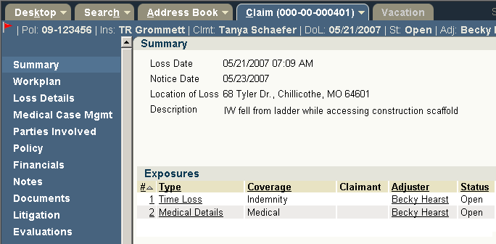

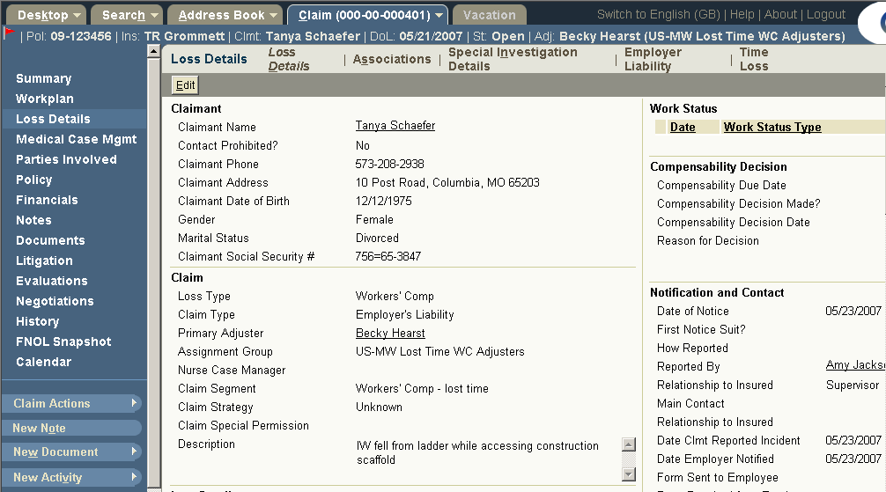

Links to Exposures
Summary screen
Loss Details screen
Notes:
In the base application, exposures can be viewed from two places:
The Summary screen has an Exposures list. You can click the links in the Type column to view that exposure in detail.
The Loss Details has a series of subtabs - one for each exposure. You can click the subtab to view that exposure in detail.

Slide 24
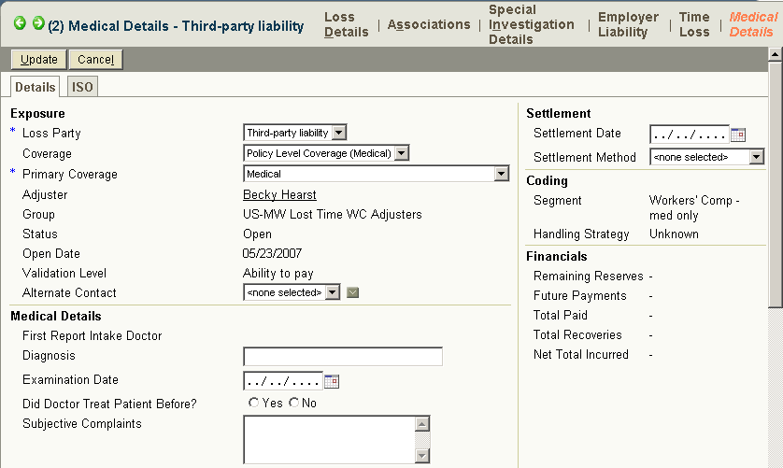
Exposure Screen: Medical
Notes:
The screenshot above is a sample medical exposure. Notice that, beyond the summary information in the upper left corner, the fields are primarily used to detail the nature of the injury and the manner in which it was diagnoses and treated.

Slide 25
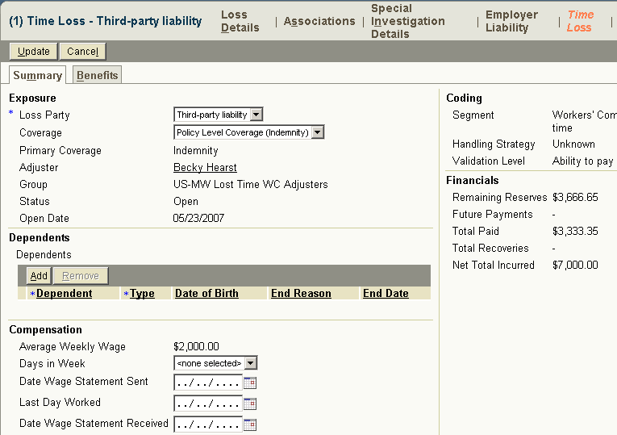
Exposure Screen: Lost Time
Notes:
The screenshot above is a sample lost time exposure. Notice that, beyond the summary information in the upper left corner, the fields are primarily used to detail the financial impact of the time that the claimant was unable to work.

Slide 26
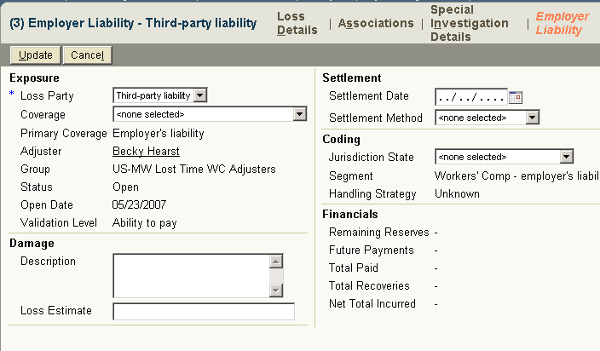
Exposure Type: Employer's Liability
Notes:
The screenshot above is a sample medical exposure. Notice that, beyond the summary information in the upper left corner, the fields are primarily used to detail the settlement between the employer and the claimant.

Slide 27
Exposure Setup
Exposure
Setup
Segment
Assign
Workplan
Initial
Reserves
Immediately after creation, exposure goes through setup
  Segmented
  Assigned to a group and user
  Exposure-specific activities created and assigned
  Initial reserves created
Notes:
Recall that whenever a claim is created, it goes through an automatic setup process which consists of three high-level stages:
The claim is segmented (it is classified so that the system knows what strategy to adopt when executing automatic adjudication logic).
The claim is assigned to a group and user.
The claim's workplan (a series of activities for adjudicating the claim) is generated, and the activities in the workplan are assigned.
Whenever an exposure is created, it also goes through an automatic setup process which consists of the same three high-level stages:
The exposure is segmented (it is classified so that the system knows what strategy to adopt when executing automatic adjudication logic).
The exposure is assigned to a group and user.
The exposure's workplan (a series of activities for adjudicating the exposure) is generated, and the activities in the workplan are assigned.
Initial reserves are created for the exposure, if possible. This occurs when business rules can use the existing information to arrive at a reasonable dollar amount for the initial reserve.
(continued)

Slide 28
(Notes Only Slide)
Notes:
If an exposure is created during the new claim wizard, then the rules are executed in this order:
First exposures are segmented, and then the claim is segmented. (This is because the claim segment may be based on the segments of its exposures.)
Then, the claim is assigned and then the exposures are assigned. (This is because, in most cases, an exposure is simply assigned to the claim owner.)
Finally, the claim workplan activities are created and assigned, and then the workplan activities are created and assigned. (This order is somewhat arbitrary, as neither process typically influences the other.)

Slide 29
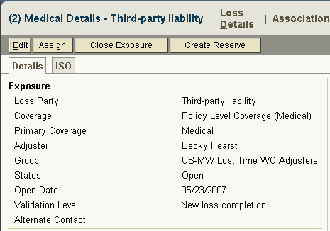
Exposure Maturity
Notes:
Recall that ClaimCenter contains a set of rules that define the data that must be present within a claim in order for it to be considered a valid "new loss" claim. These rules are run at the end of the new claim wizard.
ClaimCenter also has a set of rules that define the data that must be present within an exposure for the exposure to be considered a valid "new loss" exposure. These rules are also run at the end of the new claim wizard.
In order to make payments, the exposures must mature from the "new loss" level to the "ability to pay" level. This maturation of exposures typically occurs during claim adjudication and is discussed in greater detail in the "Adjudicating Claims" lesson.

Slide 30
Lesson Objectives
You should now be able to:
  Describe the primary information tracked in an exposure
  Create exposures

Slide 31
Review Questions
What are the primary elements of information in an exposure?
What are the three types of coverages that are typically involved with workers' comp exposures?
What is measured by an exposure's validation level?
What three high-level things occur during exposure setup?
Notes:
Answers
1. The coverage, the claimant, the incident, the reserve line.
2. Medical, indemnity (for lost time), employer's liability
3. The exposure's maturity (or how close it is to being at "ability to pay").
4. Segmentation, assignment, and creation and assignment of workplan activities.

